Slide 1
Interactive Bioinformatics Data Visualisation
Jitender
Tue 07 May 19
Informatics
CSB

Slide 2
Trends in biology papers
We will cover most common themes that we see (visualise) in bioinformatics papers
Alignment(protein/DNA) long sequences
Genes on different genomes(synteny) or their relations
Proportion of reads aligned to a Genome
RNAseq based gene expression data
Go terms
Gene Networks

Slide 3
Content
View Multiple sequence alignment (MSA) , an interactive example
Viewing Genome as circular blocks (Circos)
Reads Alignment Viewer IGV
SNP detection IGV
Gene Expression Data visualisation, Degust
GO terms using GOView
Gene networks viewing GeNeCK
Regulatory networks using Cytoscape

Slide 4
Material for the session
All at Github page:
https://github.com/gitbackspacer/data-visualisation-course

Slide 5
Trouble with Genomics data visualisation Data Ink Ratio
Data_ink / Total ink used to print the graphics
Colours
Fonts
Big Data cant load all at once
Showing sequence as reads intervals: reads doesn’t map to a point
Multiple data set into single view: not a single gene but neighbourhood
Multiple chromosomes and Whole genome context: all chromosome in a single view
Long range and complex variations
Excel sheets: “a useful container isn't automatically a useful presenter” The table presents individual data points very well and patterns that they compose very poorly.

Slide 6
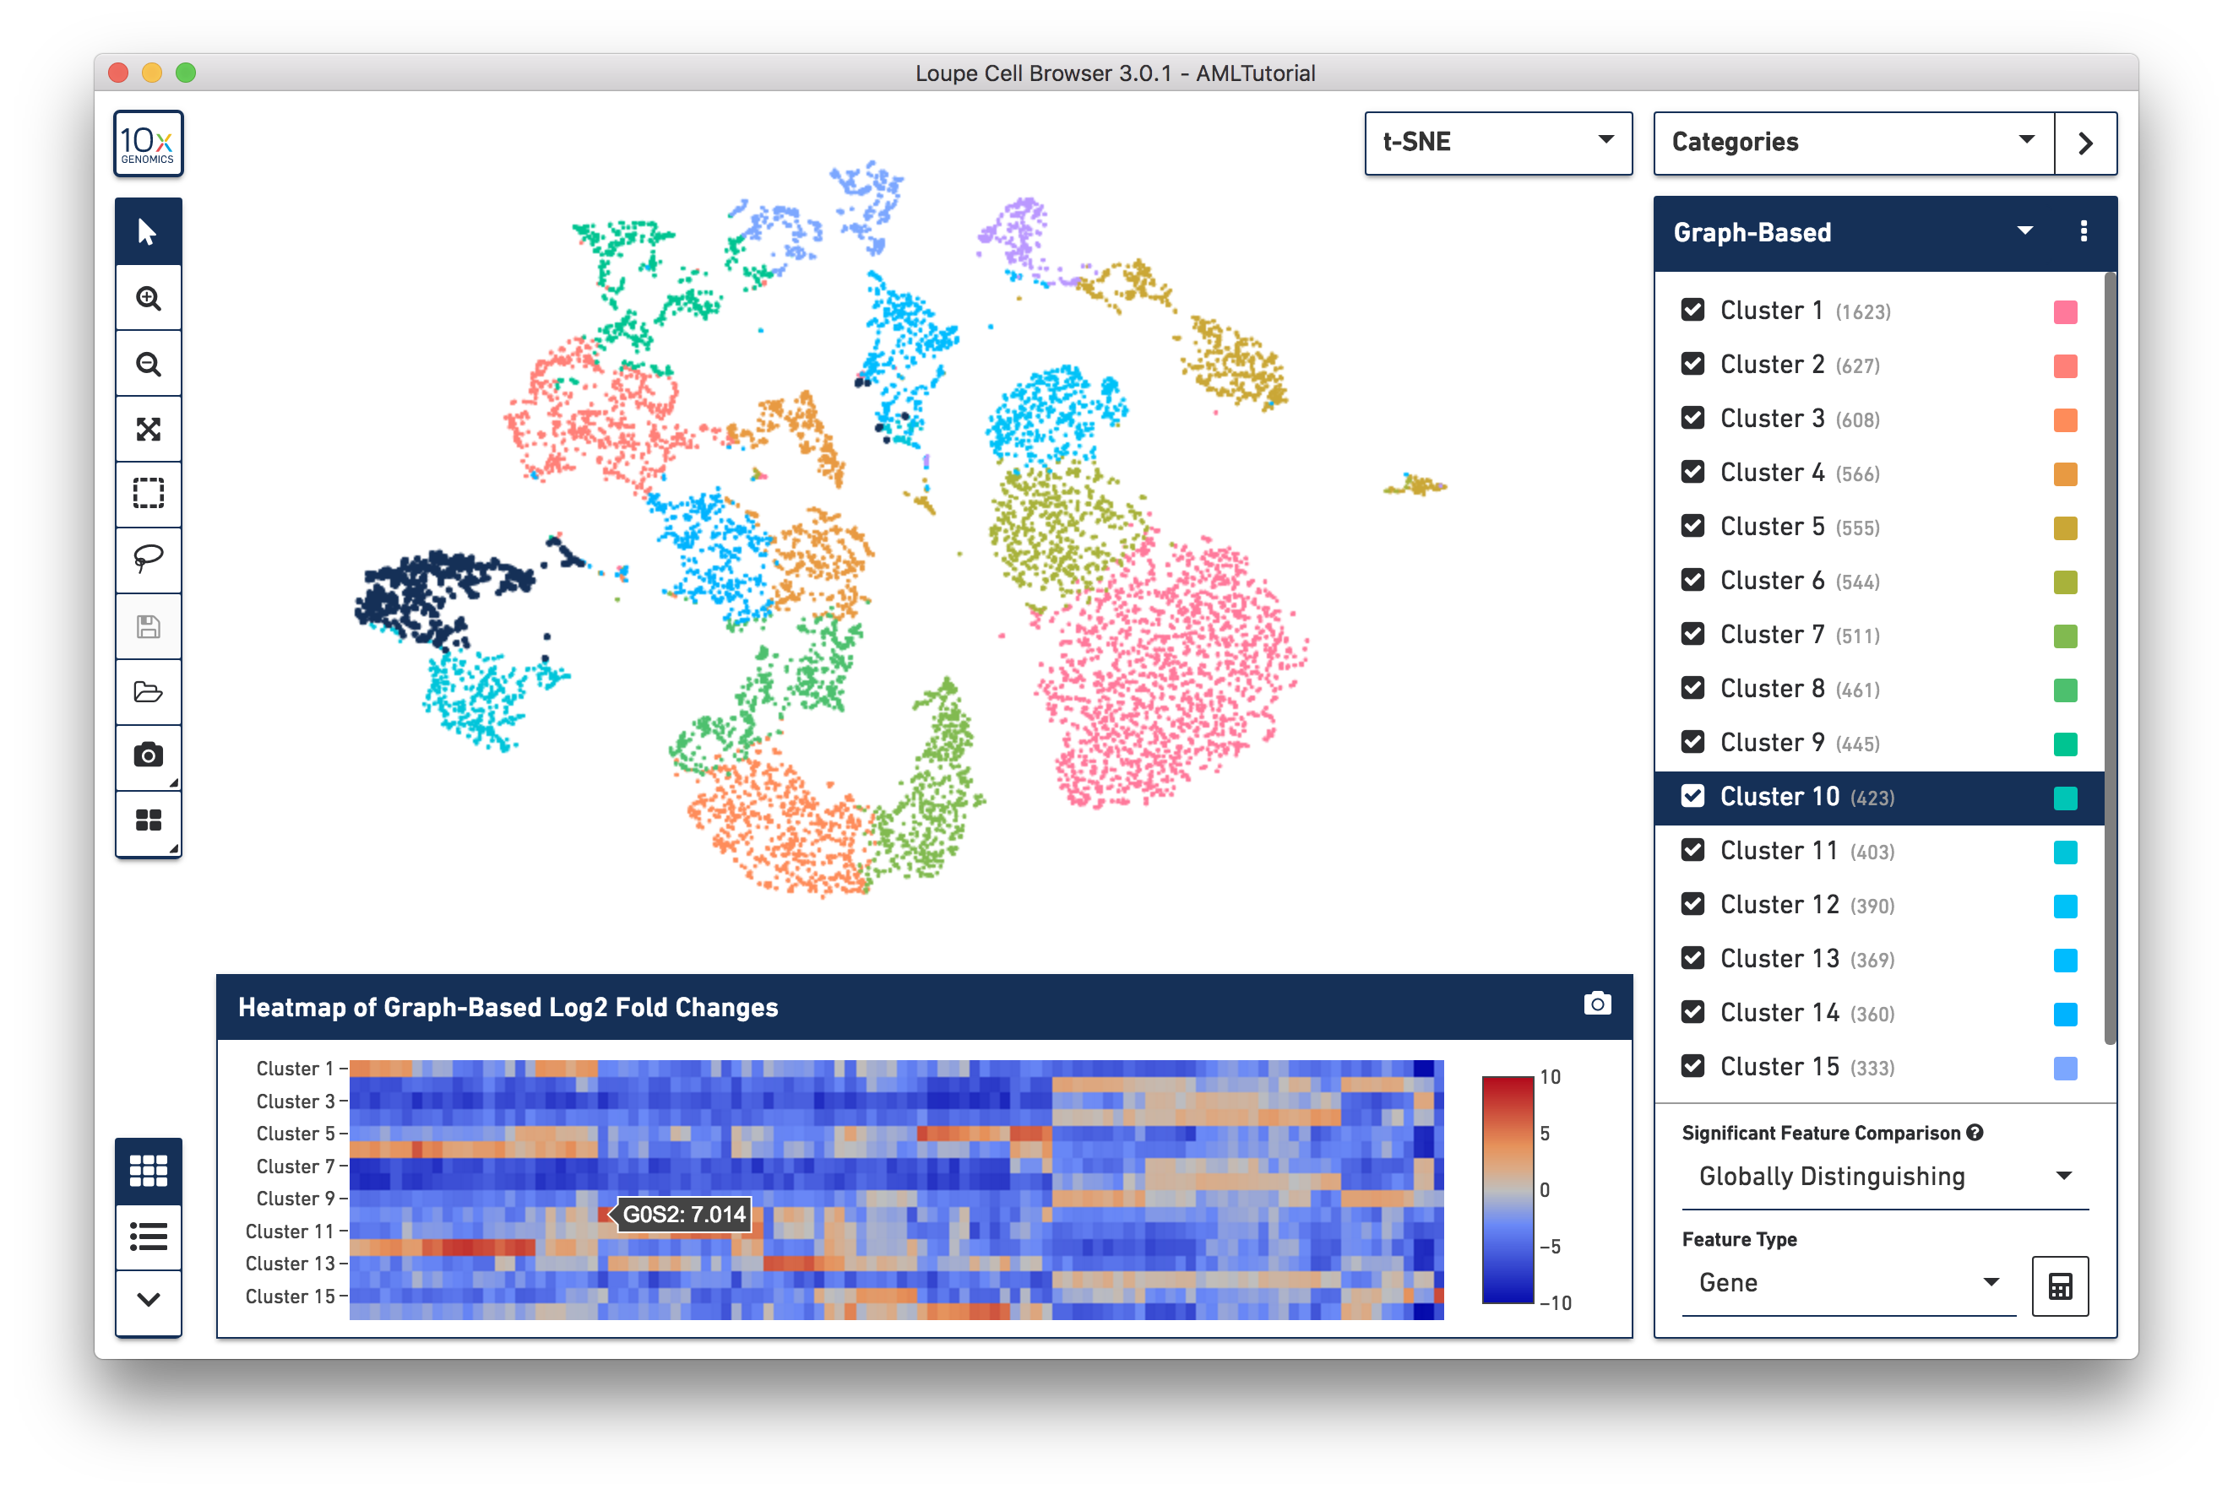
Big data
https://support.10xgenomics.com/single-cell-gene-expression/software/visualization/latest/what-is-loupe-cell-browser

Slide 7
The 25 Best Data Visualizations of 2018 A list compiled by Orana Velarde
https://visme.co/blog/best-data-visualizations
We can have a vote on this which are your top 3
What features did you like ? and what lead your ranking
I’m sure you would agree there is a space for “a bit of an artistic license”: lot of creativity is need to make a better data-viz displays

Slide 8
Exercise 1: MSA viewing

Slide 9
Viewing Multiple Sequence alignment(MSA)
https://dash-bio.plotly.host/dash-alignment-viewer
Viewer shows gap and conservation alongside a standard colorscale support and consensus sequence
No matter what size your alignment is, Alignment Viewer is able to display your proteins snappily.
You can quickly scroll through your long sequence with a slider or a heatmap overview.
Data: https://github.com/gitbackspacer/data-visualisation-course/blob/master/msa/human-kinase20.fasta

Slide 10
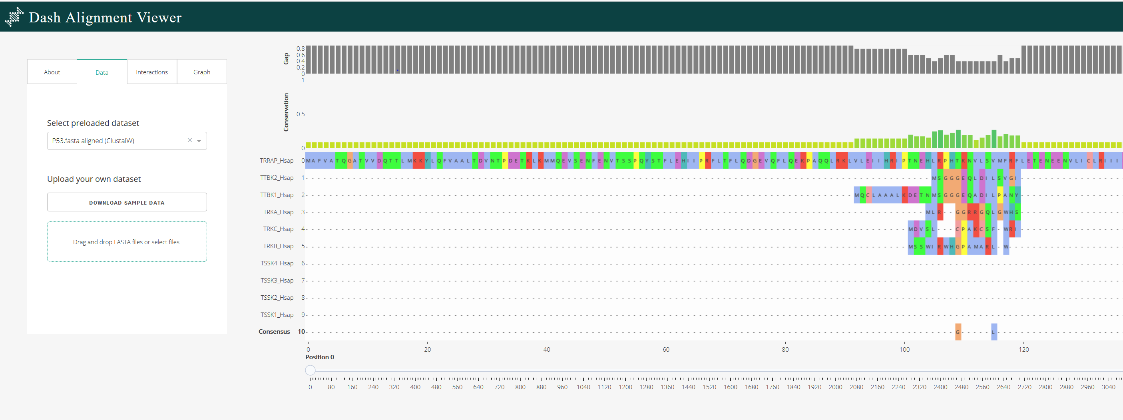
Alignment viewer step 1: Single Click on Drag drop Step 2: Browse the file “human-kinase20.fasta”
Aligned 20 Kinase Human proteins already using
Jalview “you can not only visualise but also edit”

Slide 11
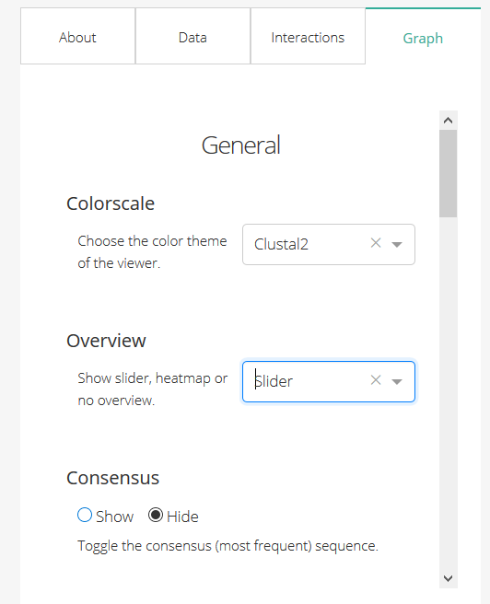
To Toggle to Slider

Slide 12
Genomic data
Complex genomic changes: copy number changes, mutations, gene expressions, methylations
Information buried all into sequencing results

Slide 13
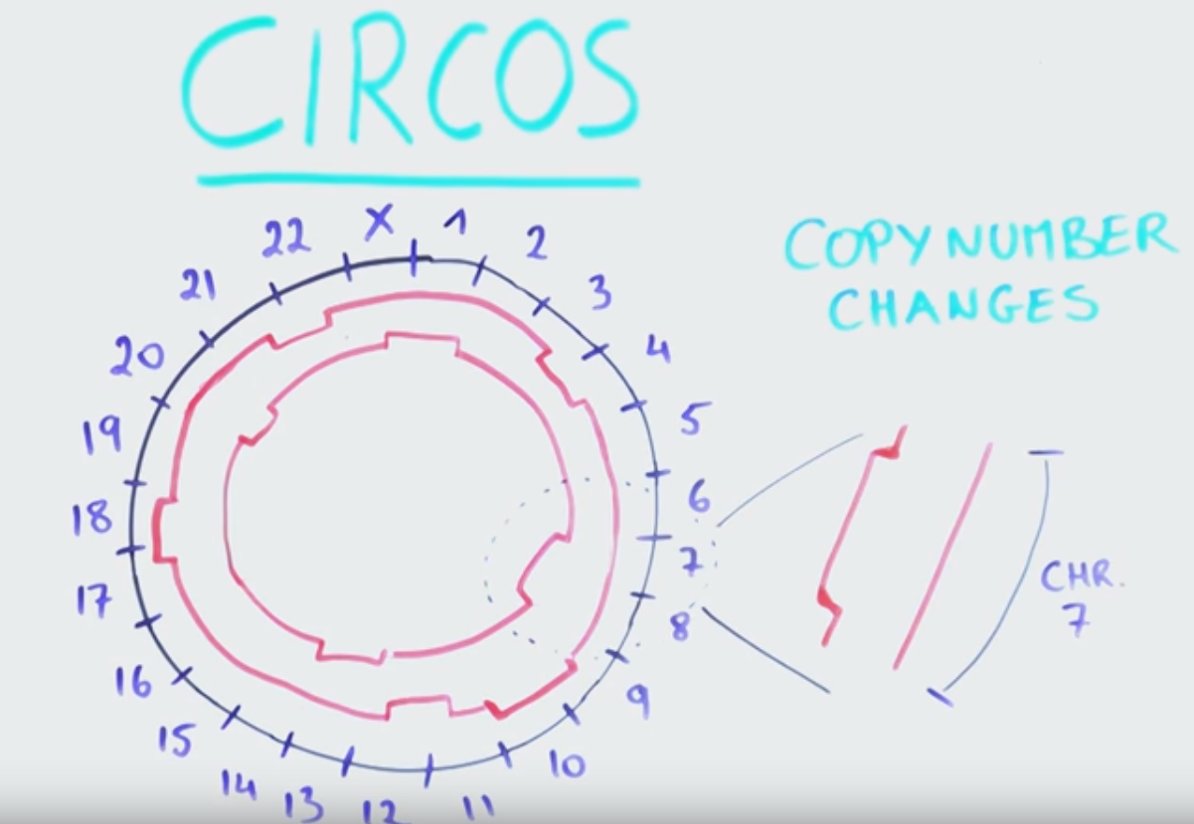
Gained or duplicated :outward
Lost: inwards
Compare two tumours or individuals
Thanks : YourekaScience https://www.youtube.com/watch?v=aY7-VFqwzlY

Slide 14
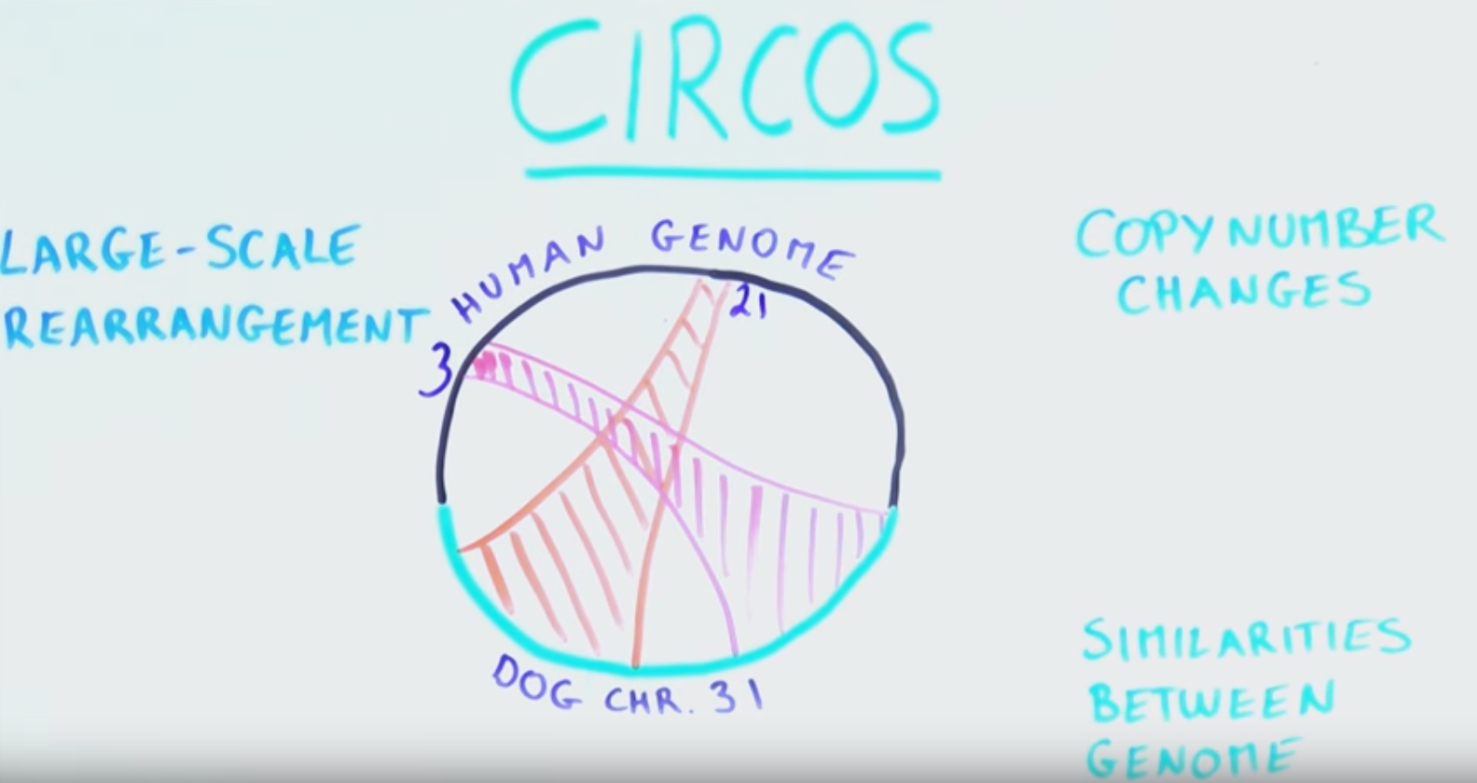
Thanks : YourekaScience https://www.youtube.com/watch?v=aY7-VFqwzlY

Slide 15
“methods to transform information into a visual form for comprehension”
automated processes can reliably find sites where rearrangement occurs, but visualization is then needed to provide a mental image so that the detail of structural variation can be fully appreciated and understood [Wong, Nature Methods volume 9: 1131 (2012)]

Slide 16
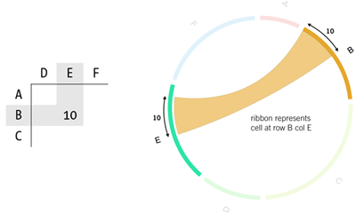
Circos
https://github.com/nicgirault/circosJS
- Please visit the link above to see how a Circos diagram can be customized
Circos is a circular visualization of data, must have seen on the cover of many Journals
Used to highlight relationships between genes, chromosome, etc for example genes that are located on different chromosomes in the genome of an organism(synteny)
http://circos.ca/intro/tabular_visualization/img/circos-visualize-table.png

Slide 17
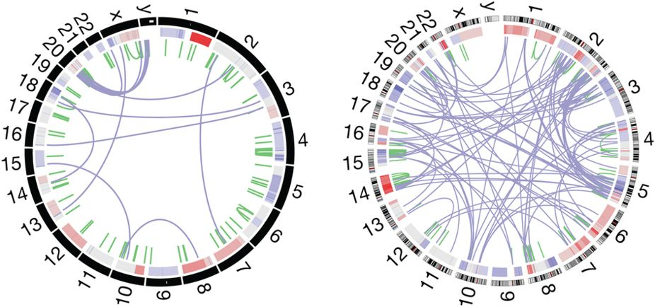
Visualisation of whole-genome rearrangement.
Two different tumours showing gene duplications and chromosome rearrangements.
The outer ring depicts chromosomes arranged end to end.
The inner ring displays copy-number data in green and interchromosomal translocations in purple [ citing: https://www.nature.com/articles/nmeth.2258/figures/1

Slide 18
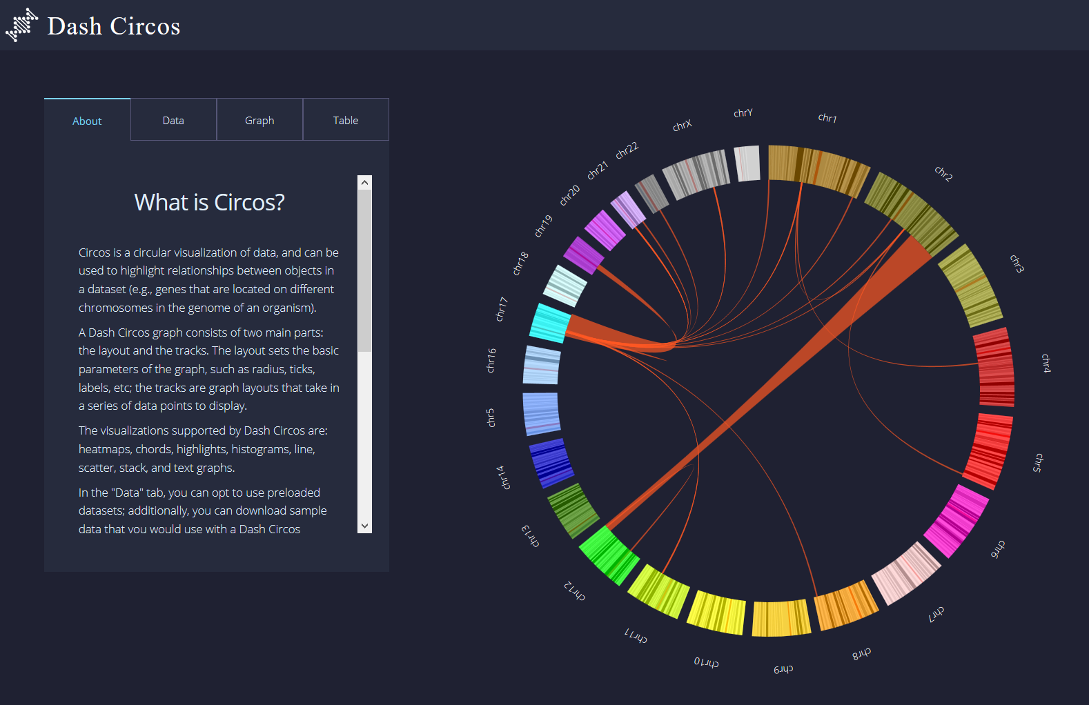
Visualize Circos: Human Chromosomes
https://dash-bio.plotly.host/dash-circos
https://github.com/gitbackspacer/data-visualisation-course/blob/master/circos_sample_data/Layout.csv
https://github.com/gitbackspacer/data-visualisation-course/tree/master/circos_sample_data

Slide 19
Exercise 2: Simplest Circos
Data : https://github.com/gitbackspacer/data-visualisation-course/blob/master/circos_sample_data/table-05.txt

Slide 20
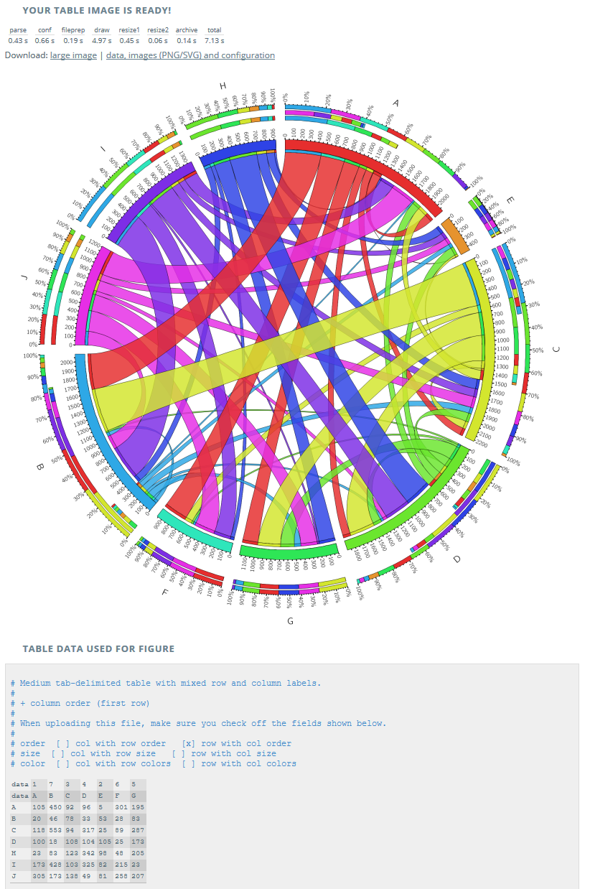
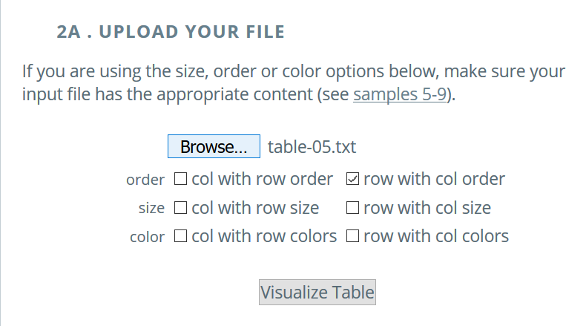
Generic Circos
http://mkweb.bcgsc.ca/tableviewer/samples/
http://mkweb.bcgsc.ca/tableviewer/

Slide 22
RNAseq data visualisation through IGV
Very popular NGS tool ‘Integrative Genomics Viewer’ Robinson et al (2011)
Integrated visualization tool for multiple data types and genome annotations.
Data from NGS analysis visualized .
Handles large datasets
Interactive and speedy visualization. Run locally on desktop
View multiple datasets in separate panels on the same panel(integrative).

Slide 23
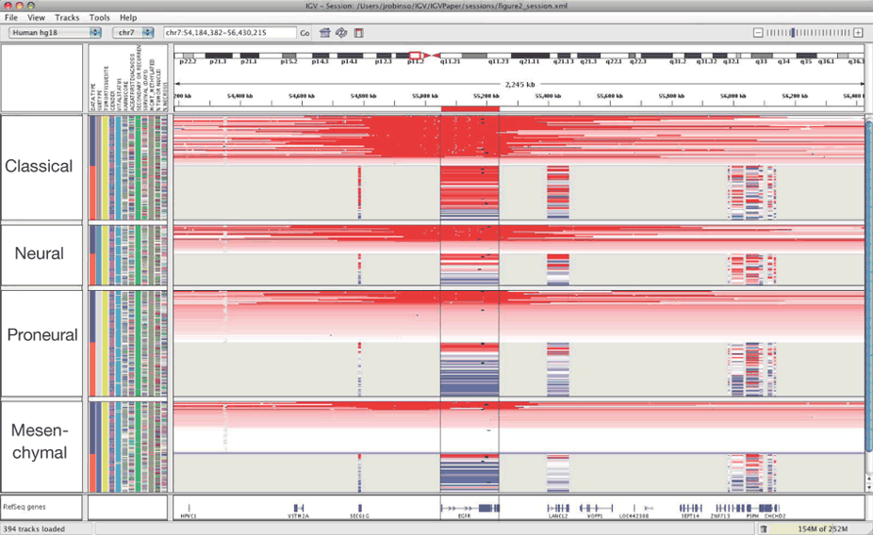
Impressive but busy https://www.nature.com/articles/nbt.1754/figures/1

Slide 24
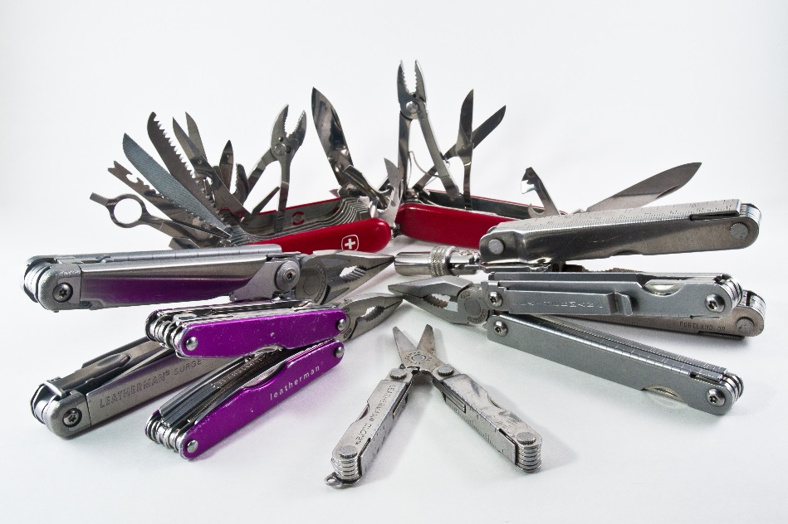
IGV DIY: diagnostics, read mapping, slice events, SNPs, Insertion , deletion, copy numbers, Errors
https://www.flickr.com/photos/pennuja/5363515039/

Slide 25
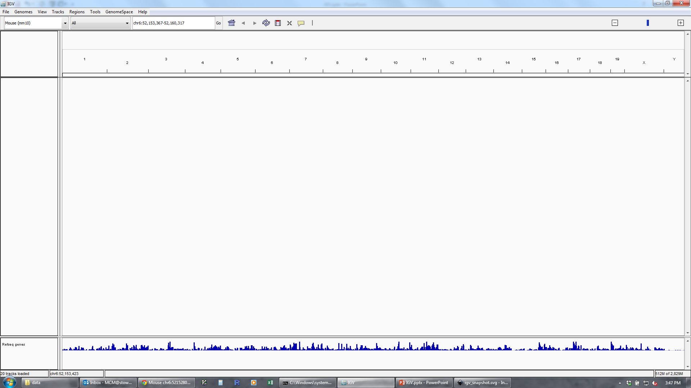
Basic Layout IGV
Genome
Navigation
Configuring Track Visibility
Data Tracks
Annotation Tracks

Slide 26
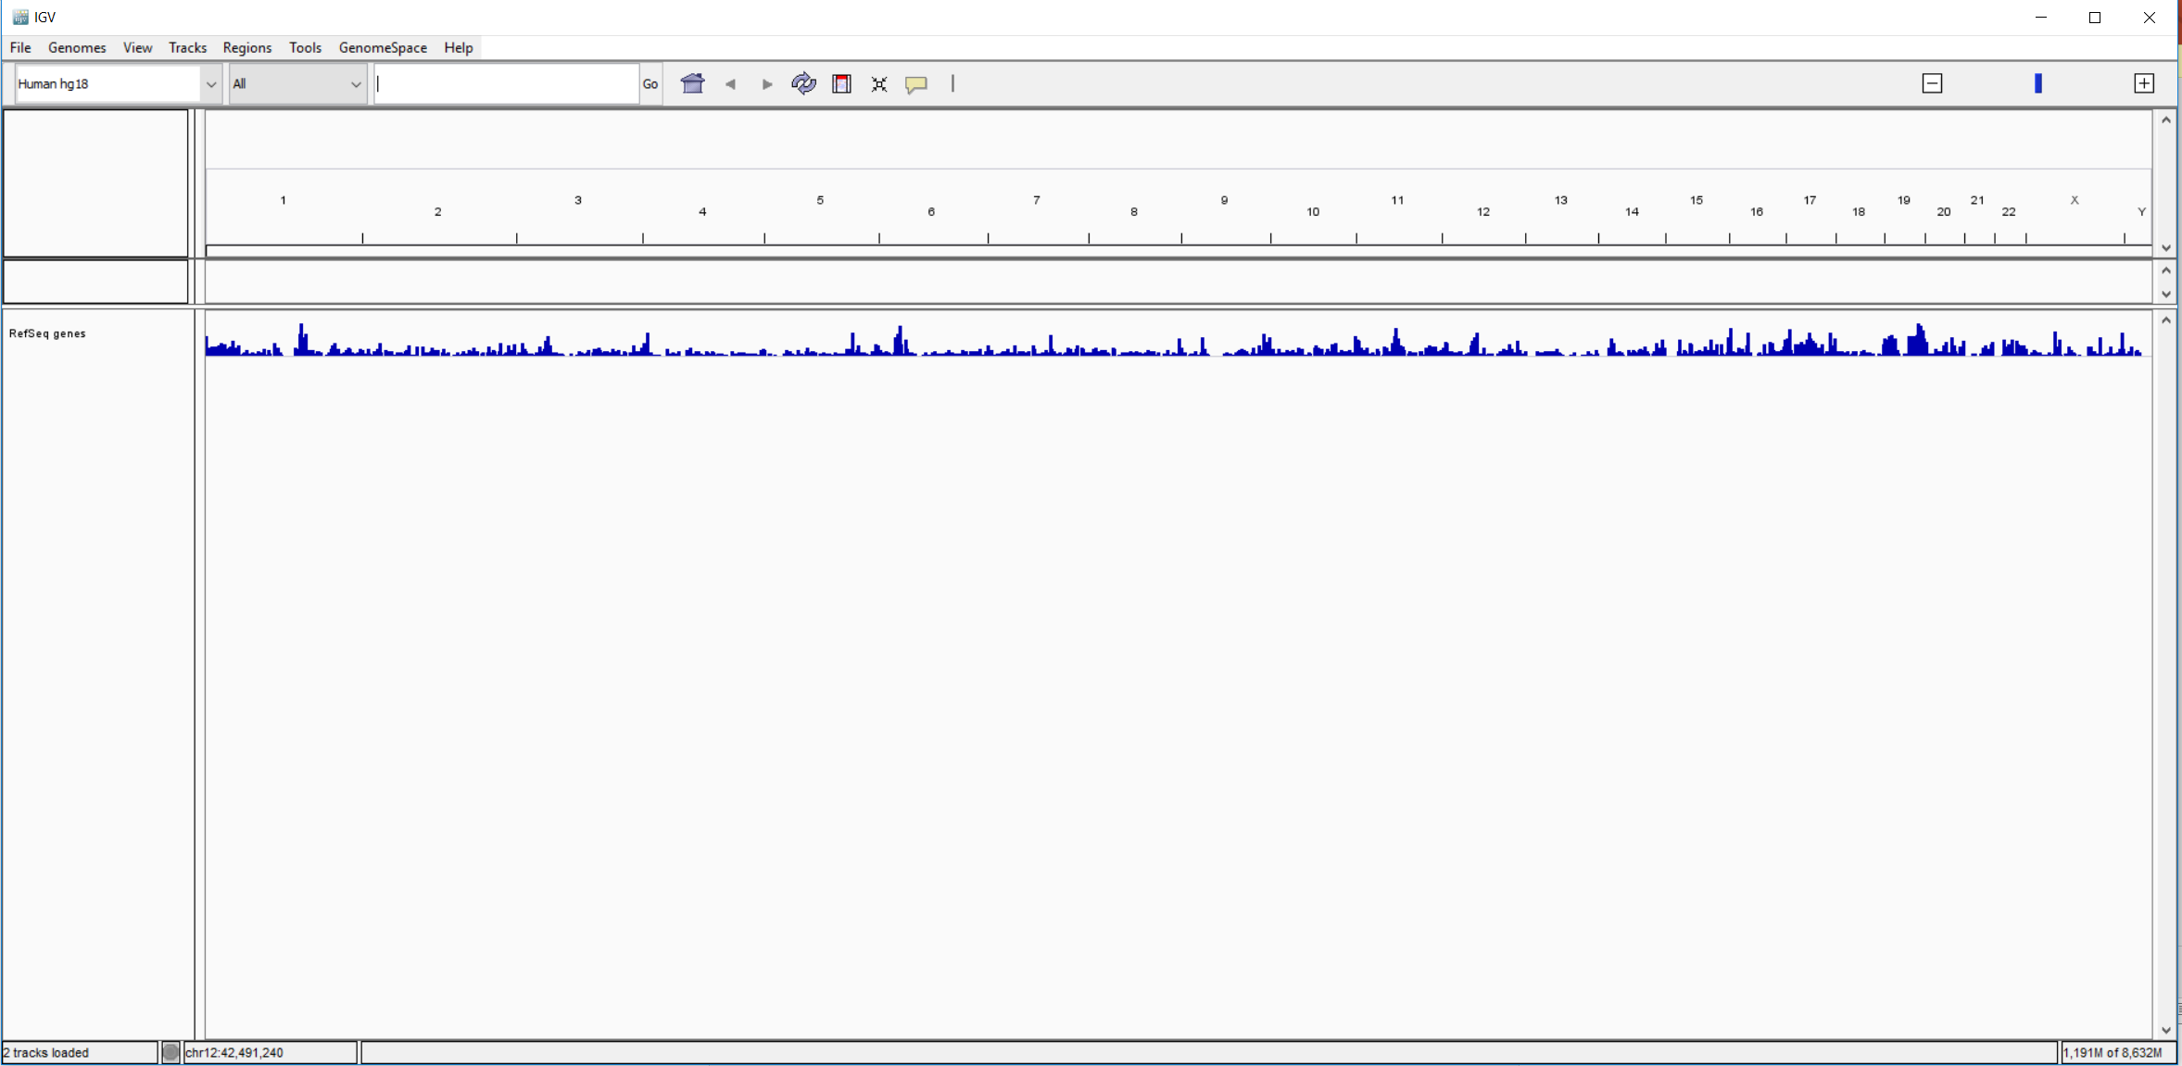
On a clean slate “Load your genome”

Slide 27
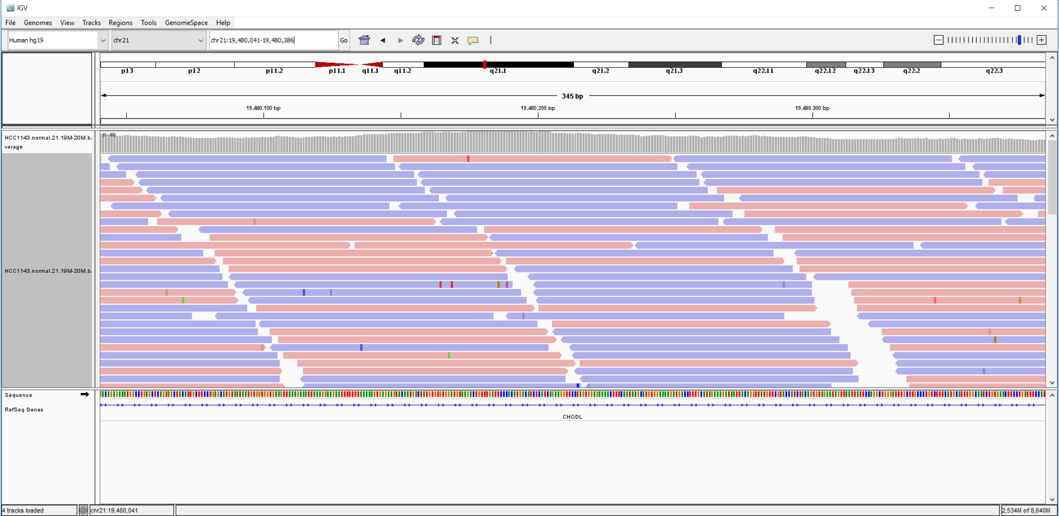
Load IGV loads Human hg19.
https://github.com/griffithlab/rnaseq_tutorial/wiki/IGV-Tutorial
Breast cancer cell line HCC1143 to visualize alignments, only a small portion of chr21 will be loaded (19M:20M) using File.. Load from File
“HCC1143.normal.21.19M-20M.bam”

Slide 28
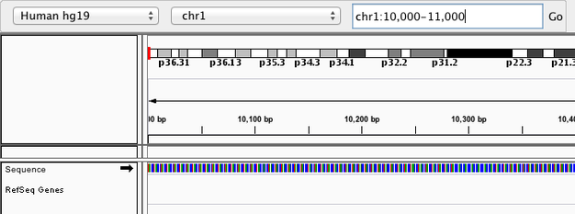
Navigate to a region

Slide 29
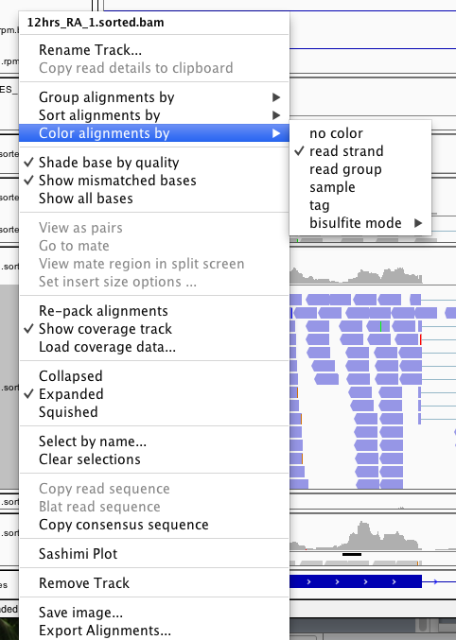
Right click on track name to change a bunch of stuff…

Slide 30
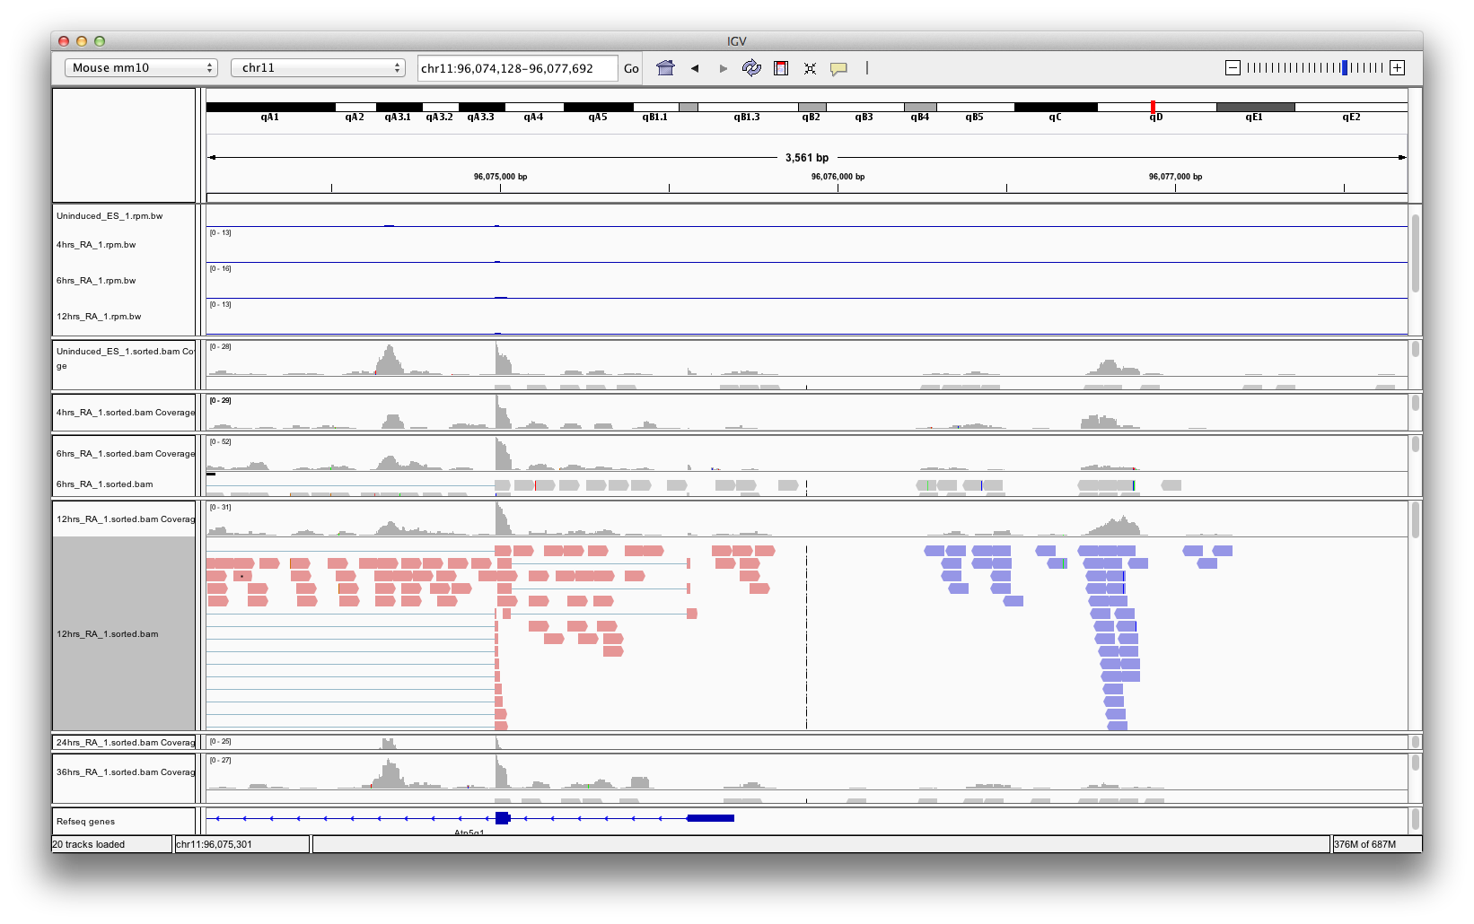
Color alignments by strand

Slide 31
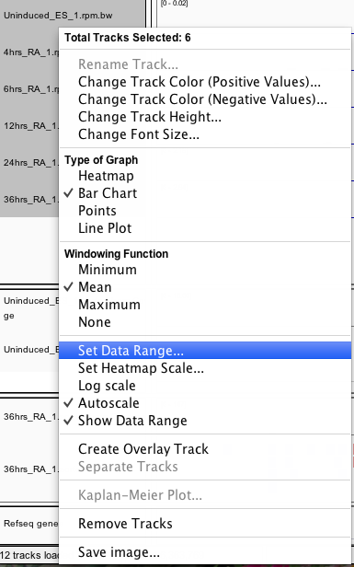
Scale

Slide 32
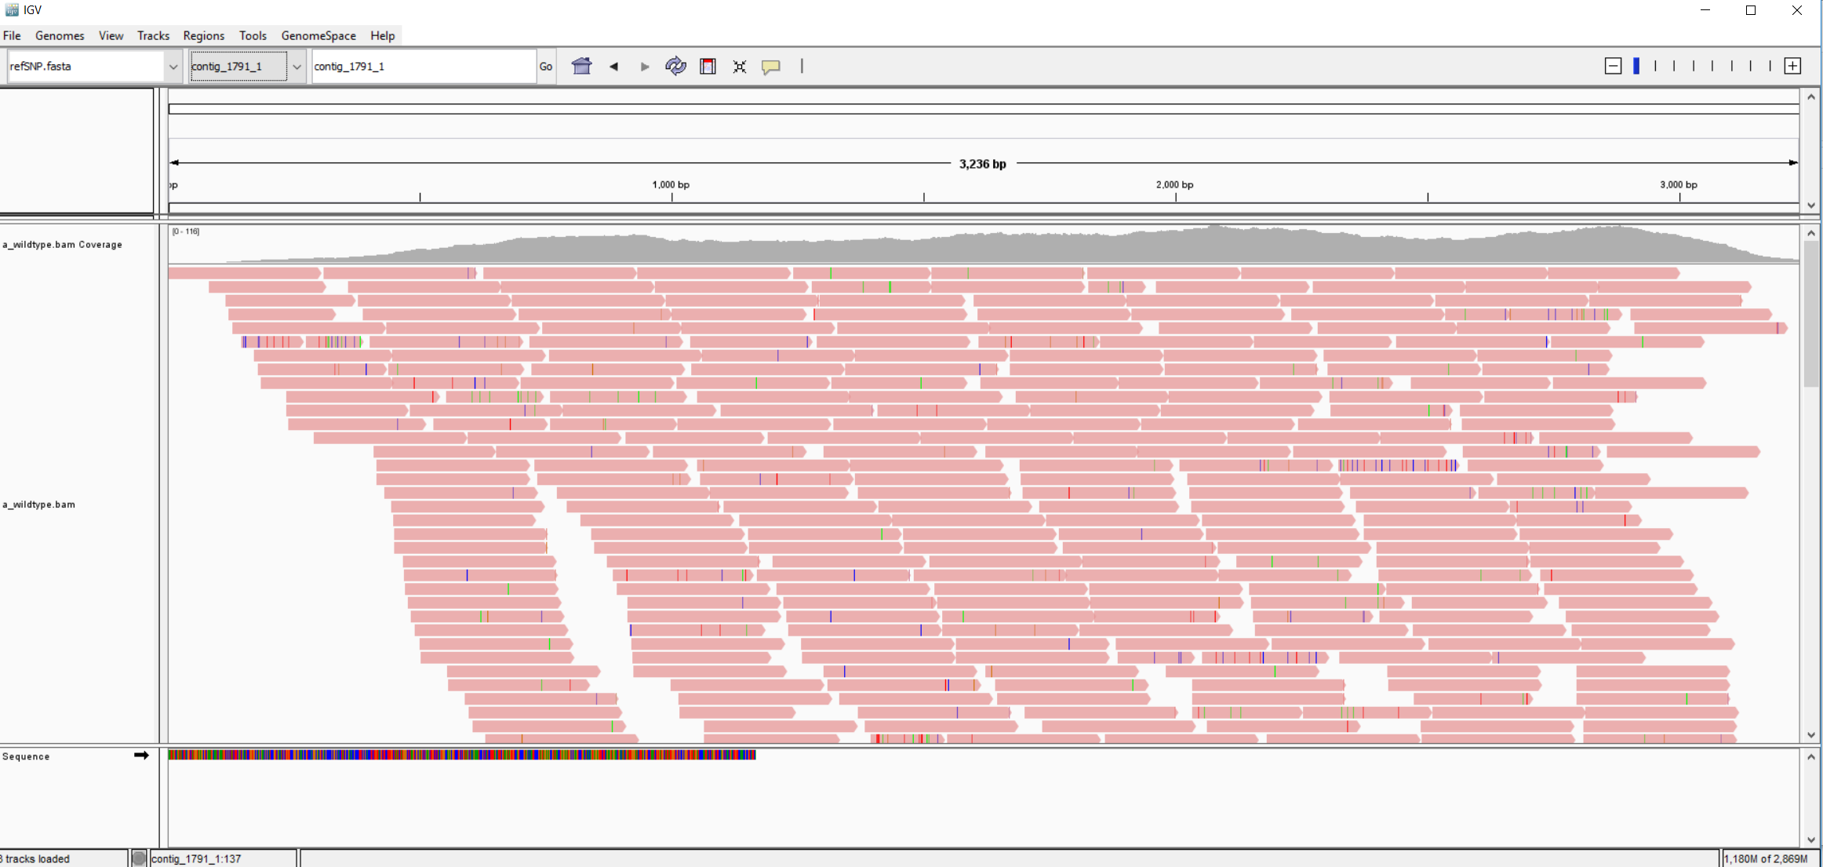
Load your own BAM
igv-mutant-data/refSNP.fasta
igv-mutant-data/a_wildtype.bam

Slide 33
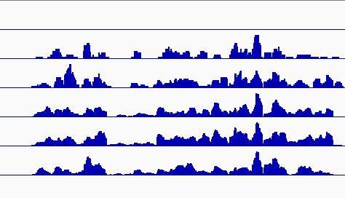
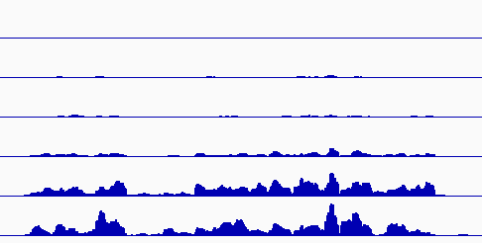
Know your scale…
Autoscale
Set Data Range

Slide 34
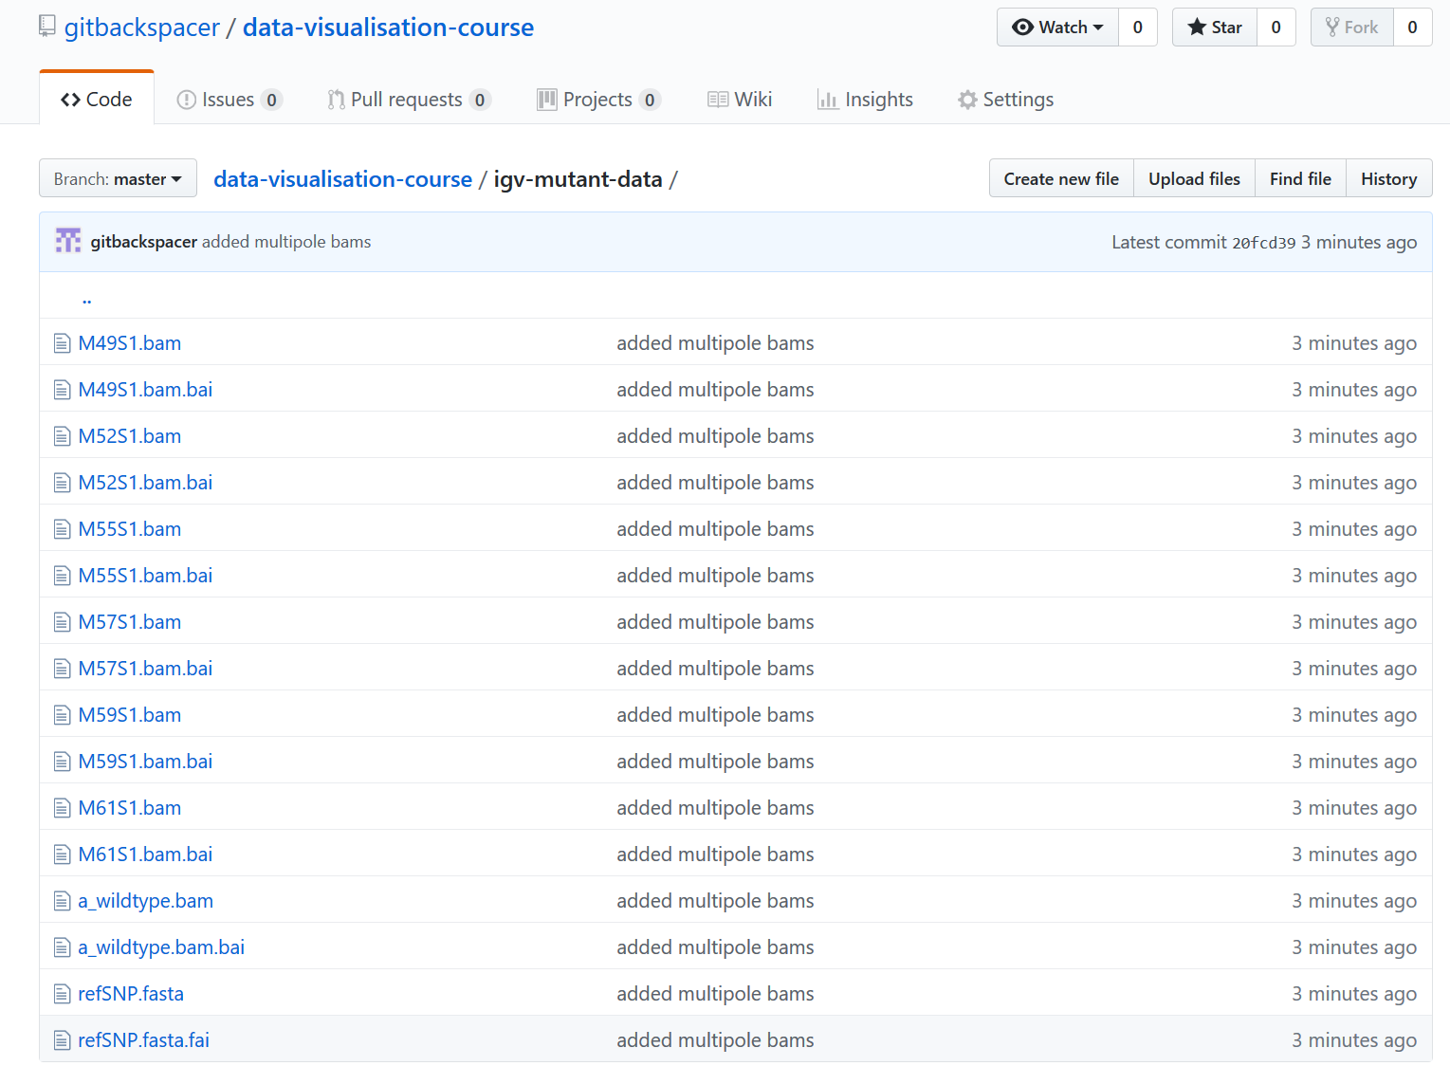
Exercise Visualise and Locate SNP
Data: https://github.com/gitbackspacer/data-visualisation-course/tree/master/igv-mutant-data

Slide 35
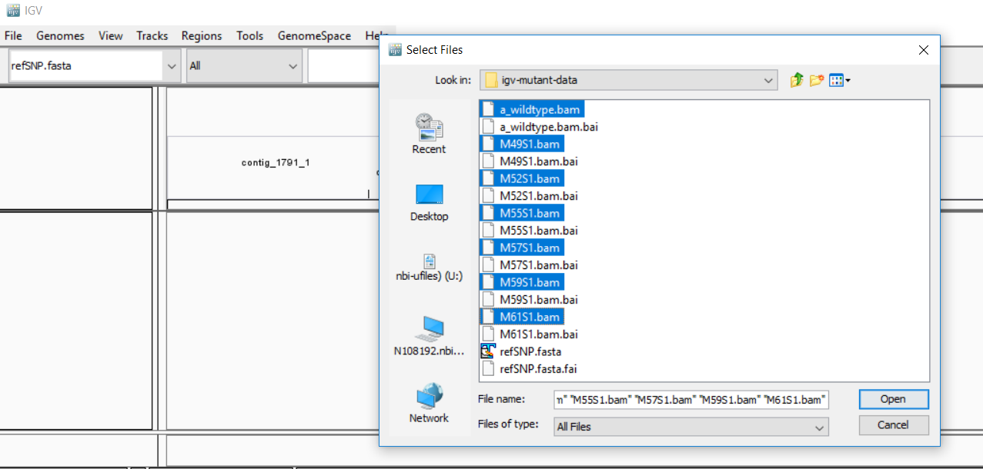

Slide 36
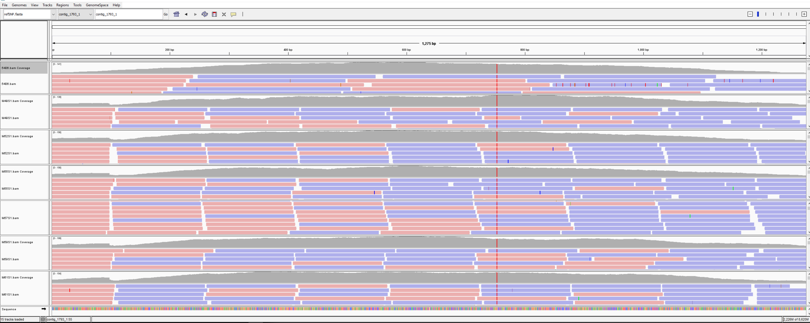
Wild type and 6 other mutants from an unknown species

Slide 37
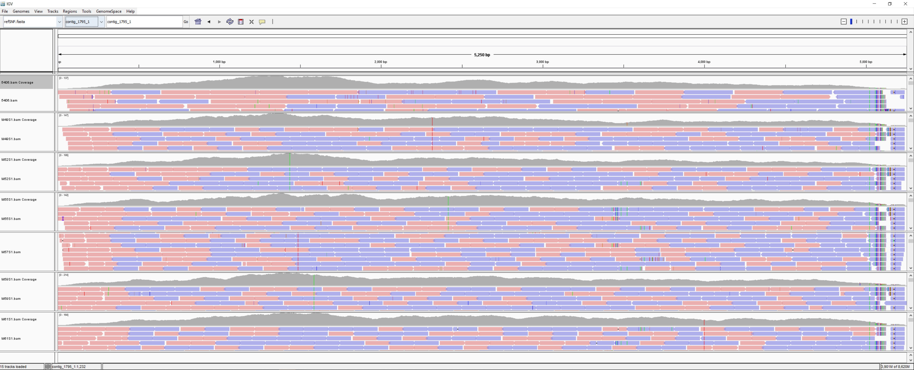

Slide 39
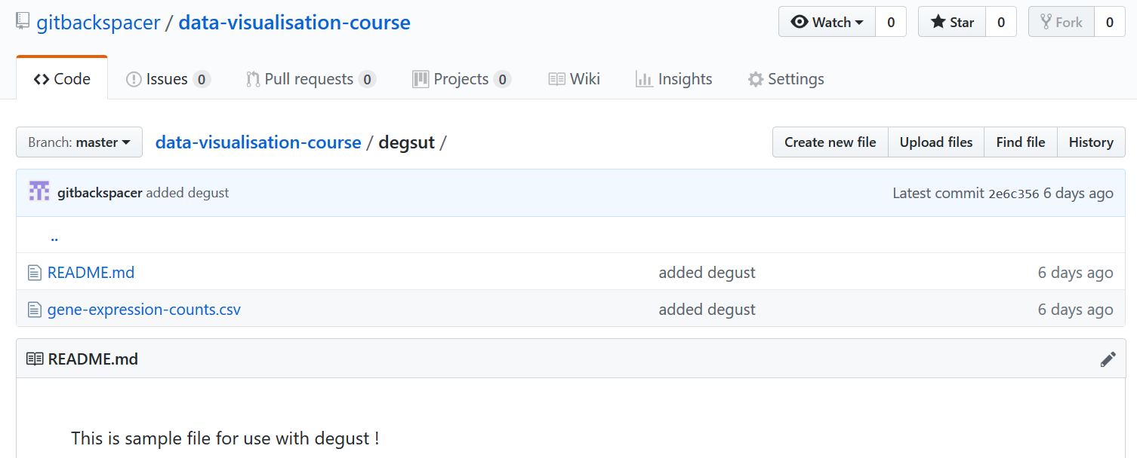
Gene Expression data: Exercise

Slide 40
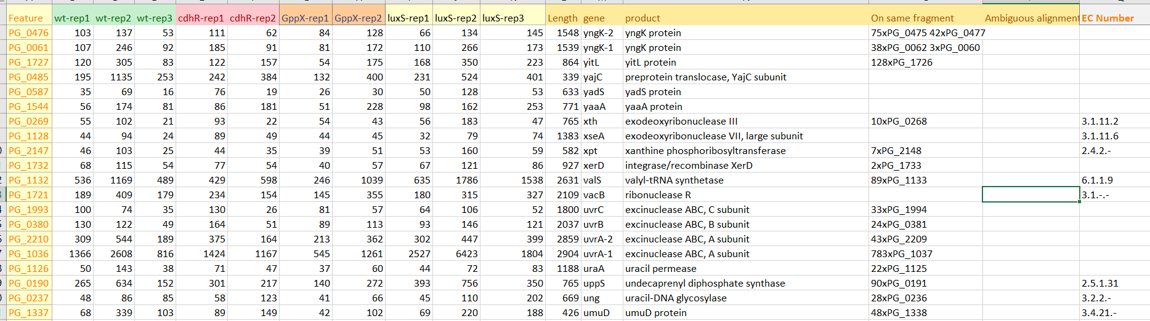
Gene Expression Data
We have count files for each gene as “CSV” file
http://degust.erc.monash.edu/degust/config.html?code=d24c2a88f917954853272af3e80cde5a

Slide 41
Degust
We can upload a CSV file containing your own analysis (eg. from Limma/Voom, edgeR or DESeq).
It is very interactive

Slide 42
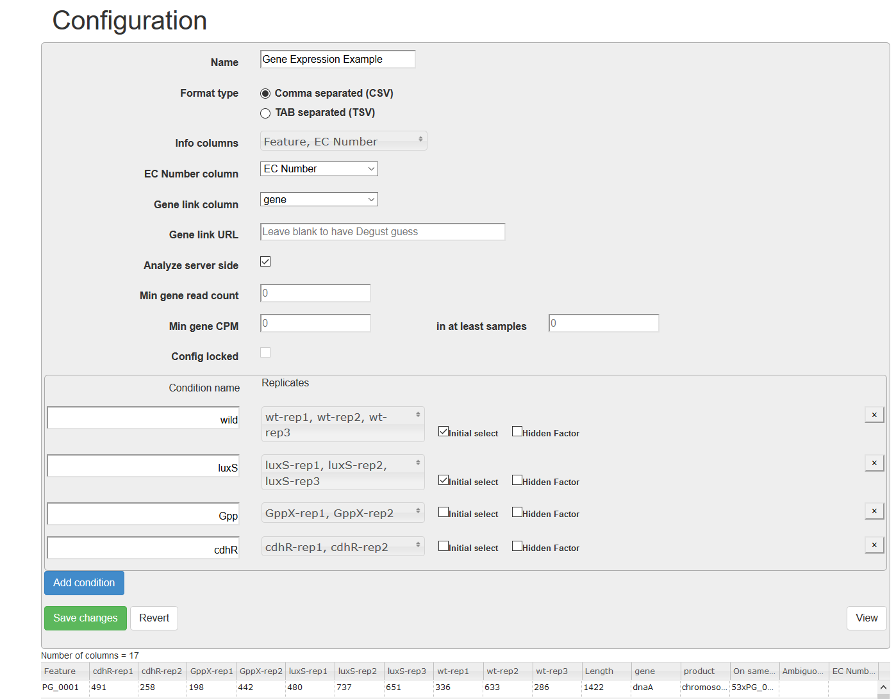
Replicate information

Slide 43
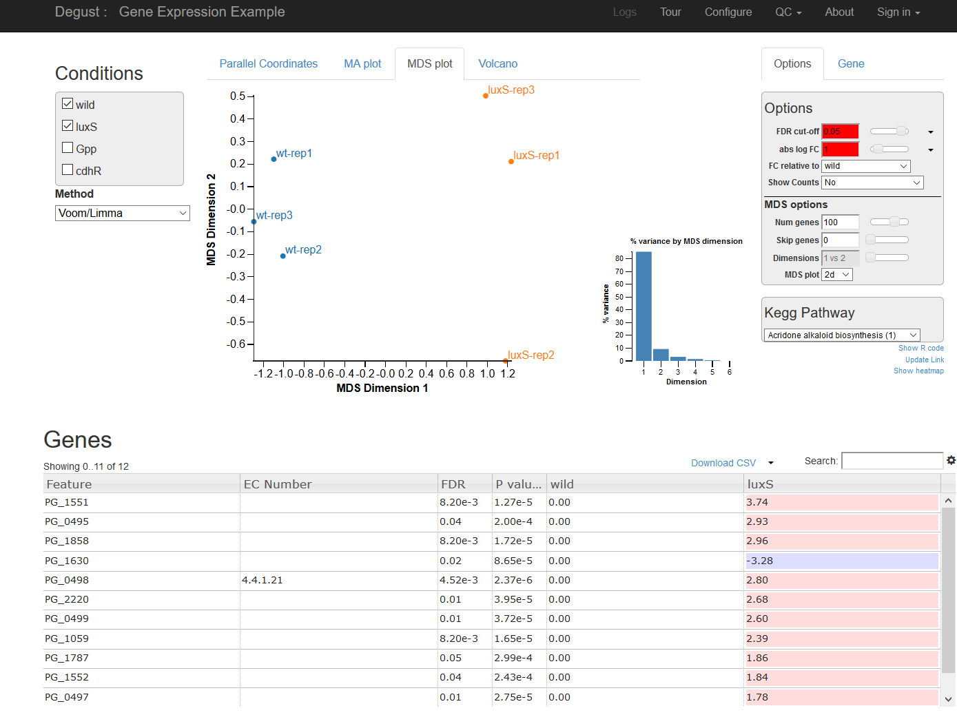
Check two conditions comparison: Verify replicate robustness

Slide 44
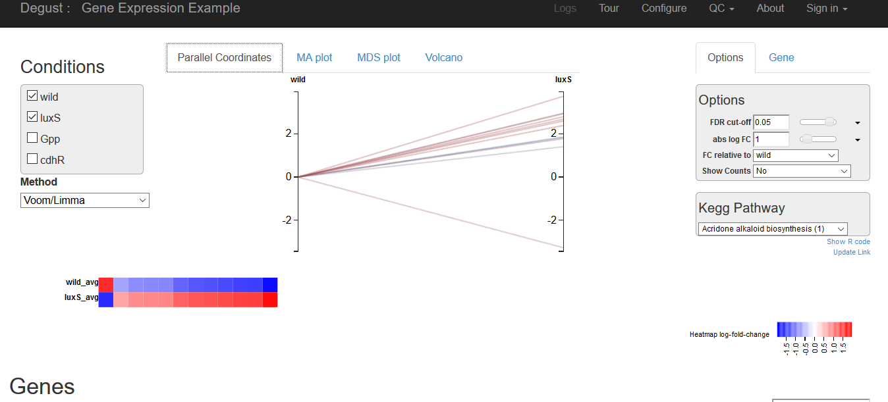

Slide 45
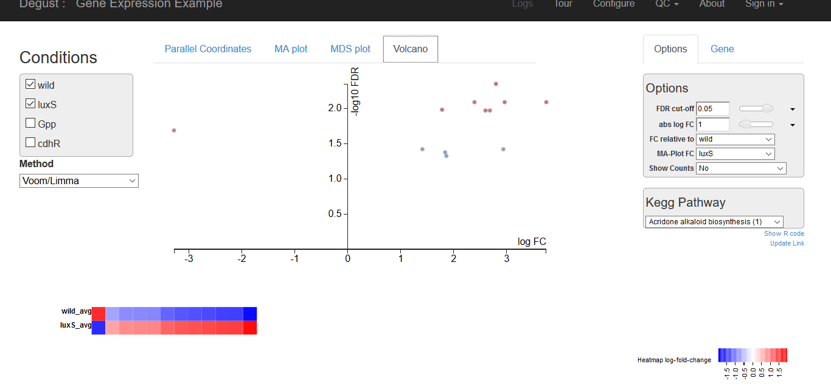

Slide 46
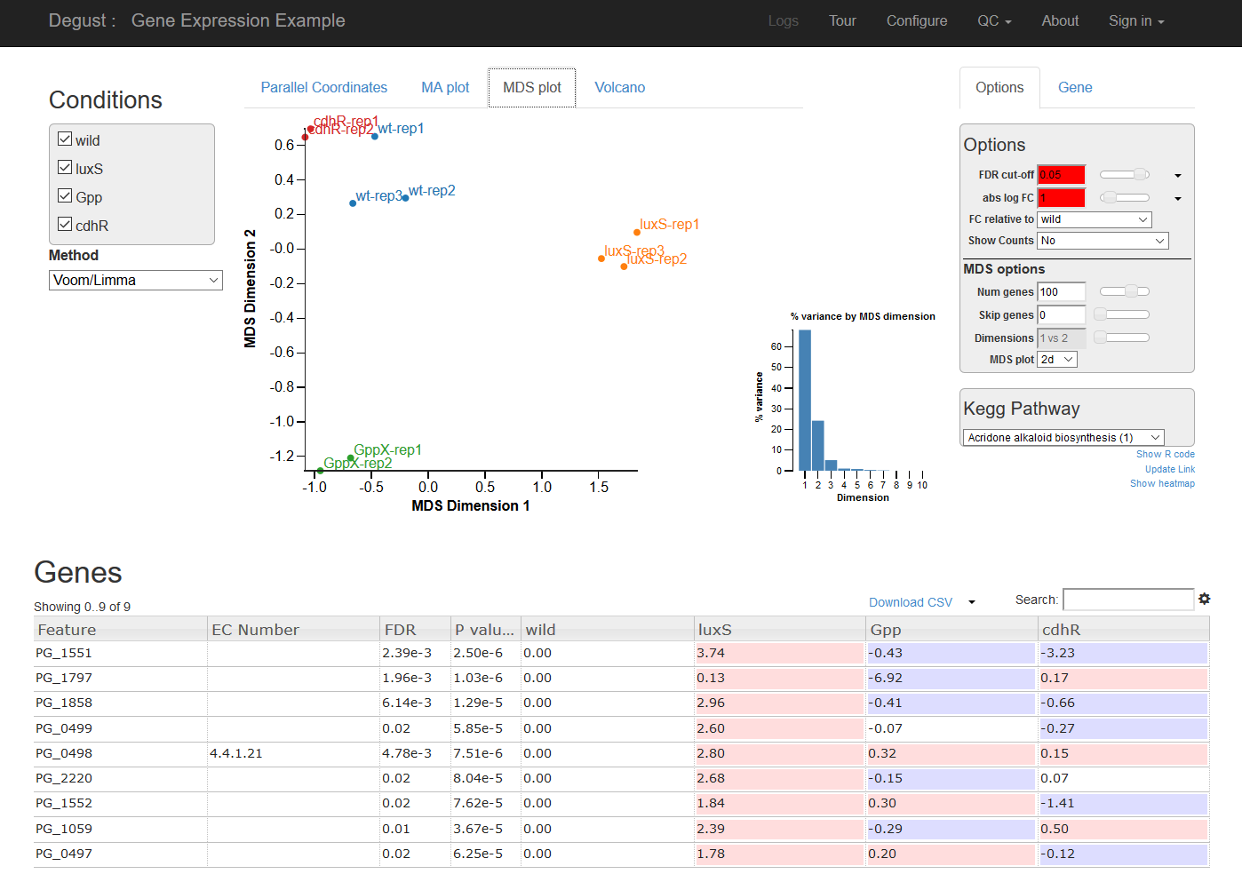
Switch all condition comparions

Slide 47
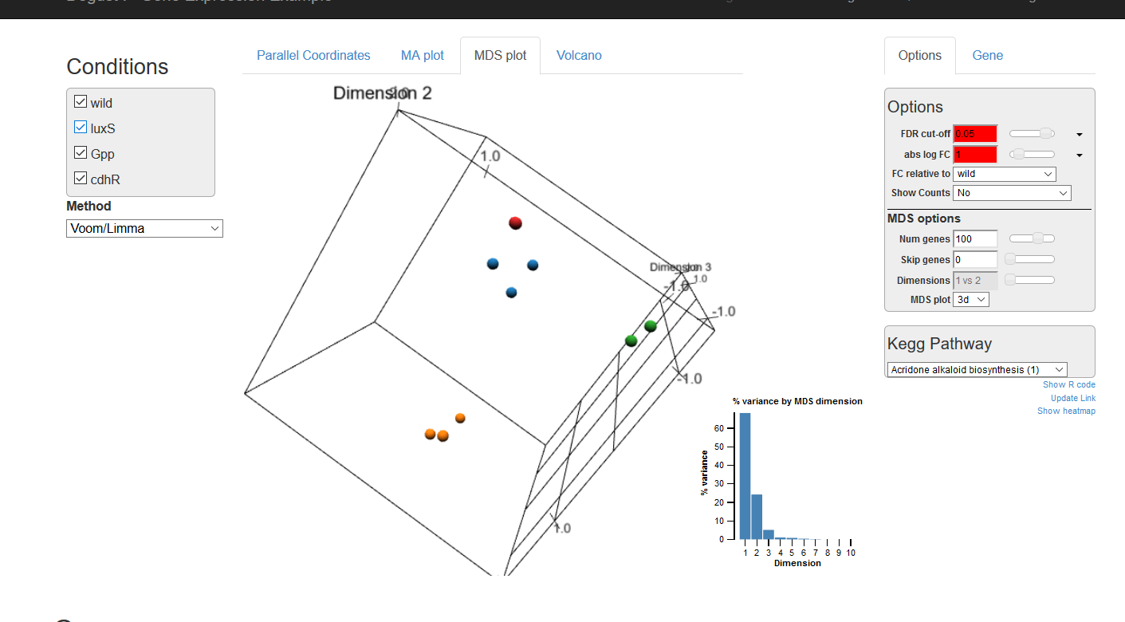
3D mds

Slide 48
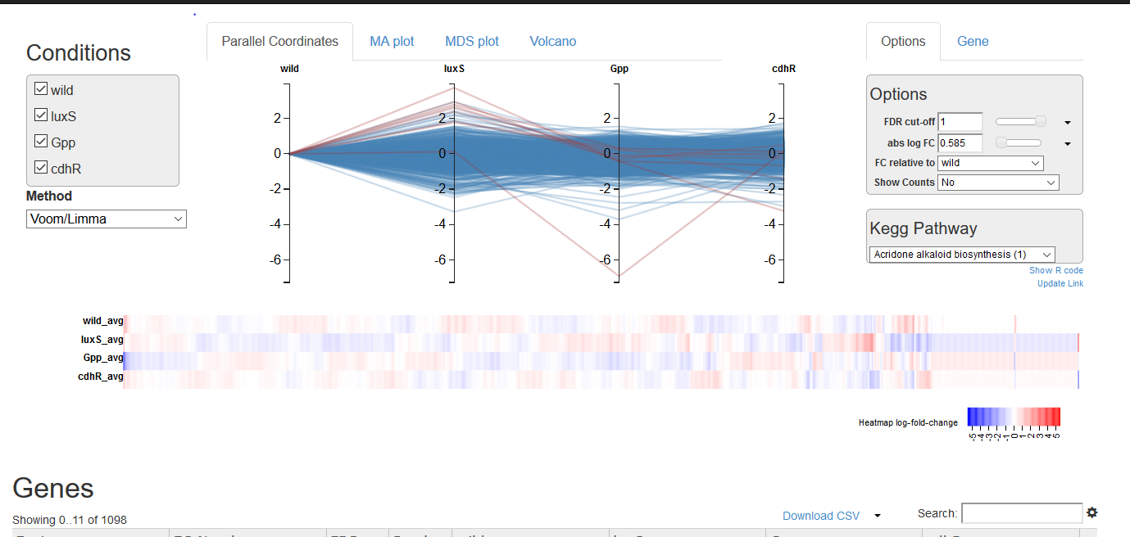
All conditions line plots; trends; can rearrange

Slide 49
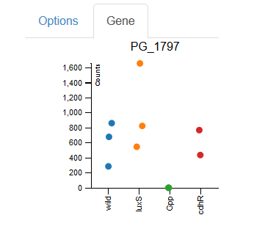
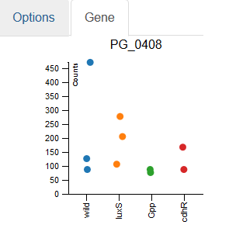
Per Gene spread option

Slide 50
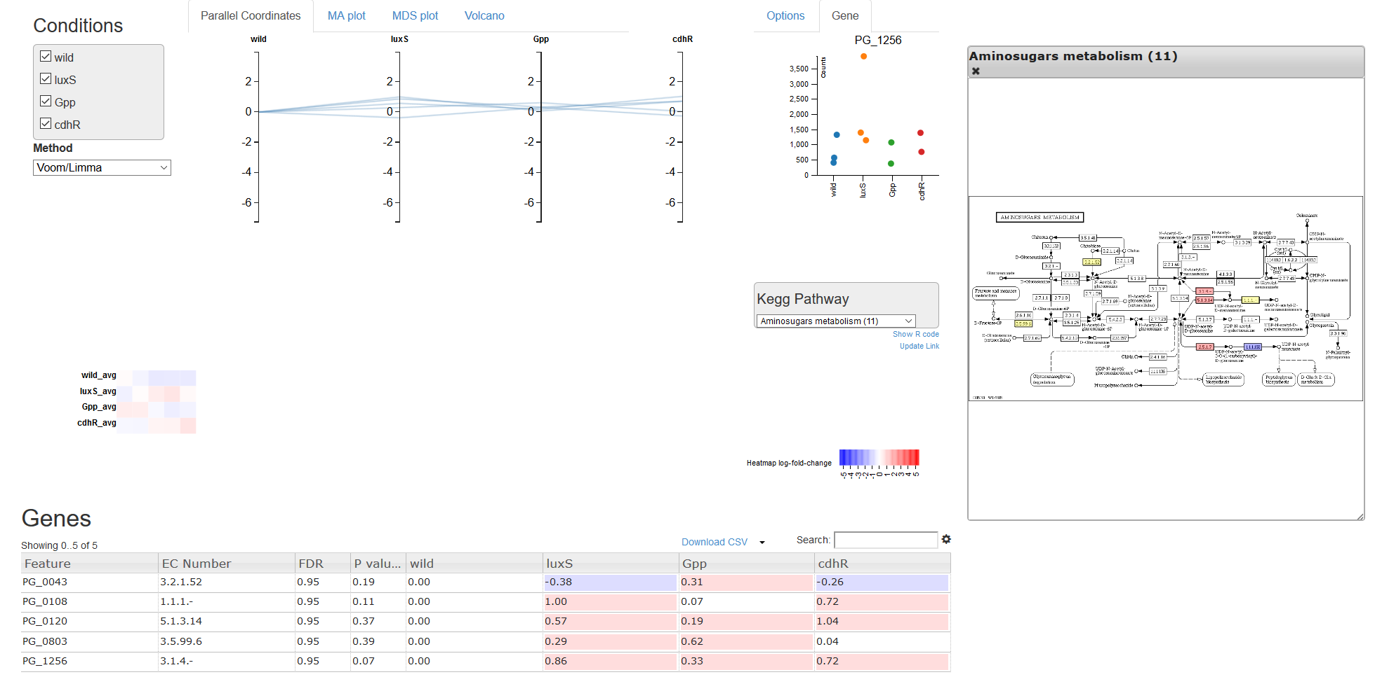
Highlight Gene on Kegg pathways

Slide 51
Go term Visualisation
http://www.webgestalt.org/2017/GOView/
GOView
View and compare Gene Ontology under DAG Structure
We will use sample file “sample.gvf” or https://github.com/gitbackspacer/data-visualisation-course/blob/master/sample.gvf

Slide 52
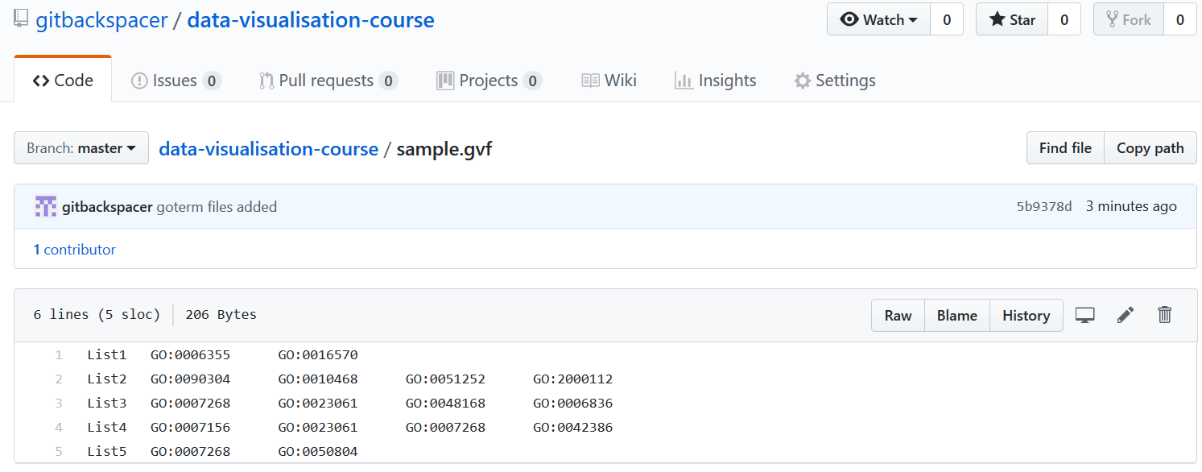
Go term File

Slide 53
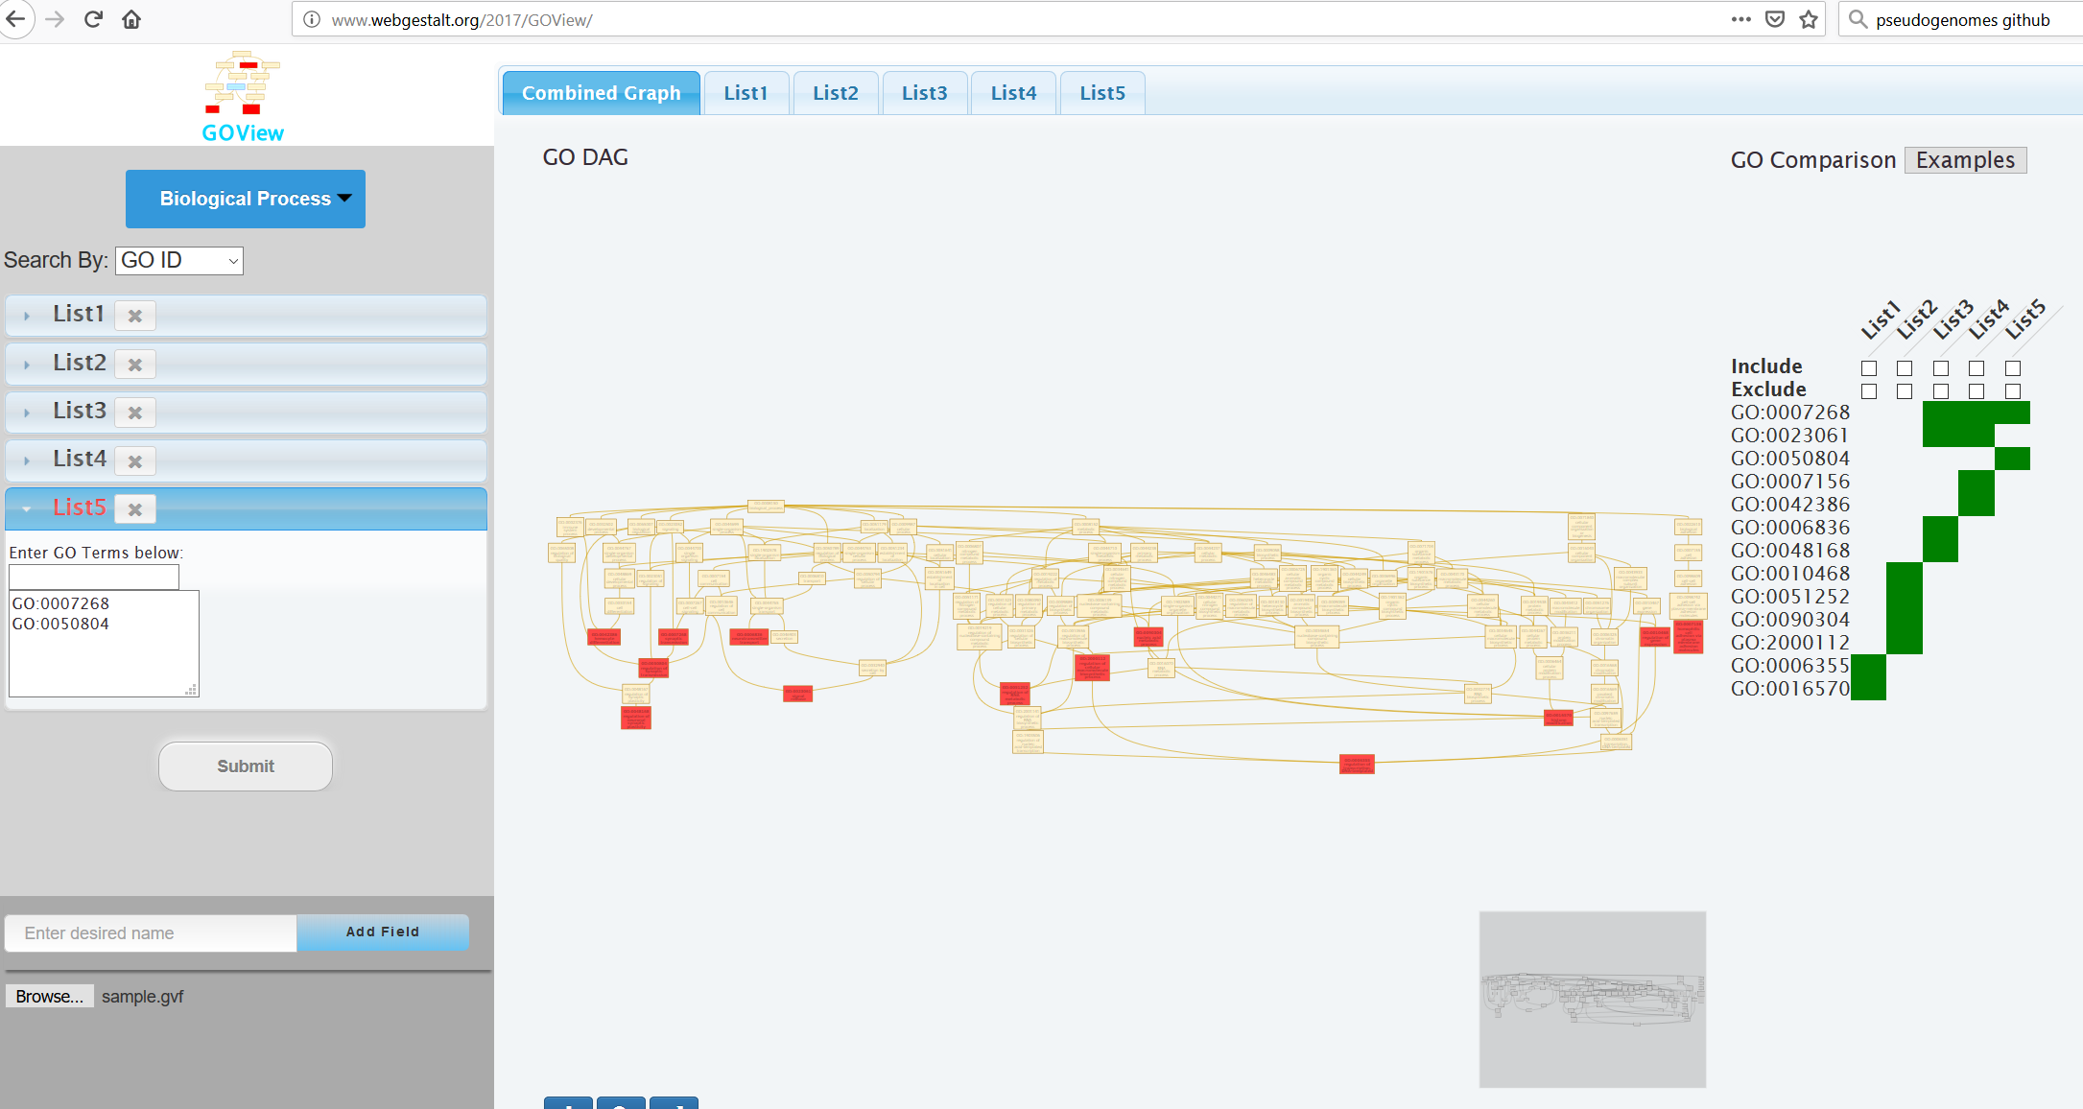

Slide 54
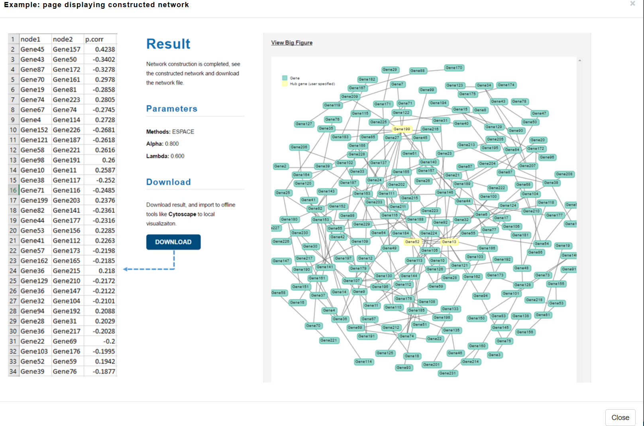
GeNeCK ( construct and visualise Gene regulatory networks)
GeNeCK: a web server for gene network construction and visualization Zhang etal, 2019

Slide 55
Meta Webserver and checkout demo
http://lce.biohpc.swmed.edu/geneck/index.php
Scale free networks

Slide 56
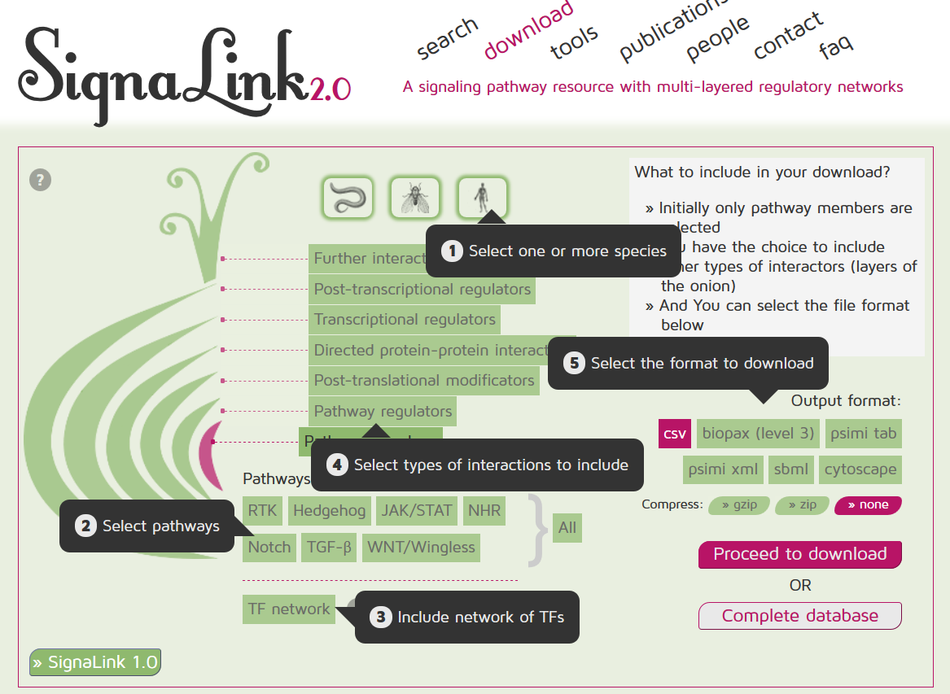

Slide 57
Data downloaded as “05062019-signalink-UTh27h.cys”
http://signalink.org/export/05062019-signalink-UTh27h.cys SignaLink export config: Species: H. sapiens Layers: Pathway members Pathway regulators Pathways: RTK Include TF network: Yes Range from pathway specific TF: 1 Format: cytoscape Compression: None

Slide 58
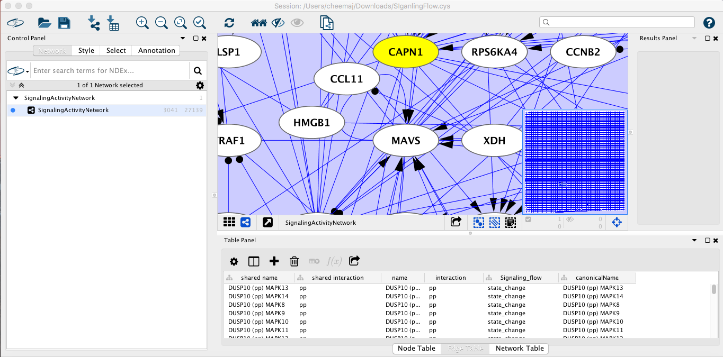
In cytoscape you can visualise the network

